Slide 1
Notes:
Chapter 14 explores the types of duties and responsibilities that belong to principals and agents. It also explains how agencies can be terminated.
Trump’s Angry Apprentice
Richard T. Fields could have been a real-life forerunner to Donald Trump’s reality show, The Apprentice. From 1995 to 1999, he learned the casino business at The Donald’s side as a consultant, and the pair had visions of expanding Trump’s NJ based gaming operation nationwide. But this partnership has turned rockier than anything depicted in Trump’s TV boardroom. A cozy relationship has given way to a blood feud, rife with allegations of dishonesty. Locked in an ongoing legal battle over a Florida casino project, Trump and Fields have filed dueling briefs that reveal the depth of their animosity. At state: more than $1 billion.
Trump charges that Fields betrayed him by snatching away a plan to build two casinos. (Fields) charges that Trump is trying to get his hands on a profitable deal that he passed up years ago. Who’s right in this war of words? From Trump’s perspective, the duties of good faith and loyalty have not been fulfilled.
Business Week News: Duties of the agent to the principal include the following: obedience, good faith, loyalty, and to account and to perform his or her duties with judgment and skill.
The Agency Relationship: Principals trust their agents to be loyal to them, and agents trust their principals to compensate them fairly. What is a relationship based on trust called? The two-way relationship of trust created between a principal and an agent is called fiduciary. The relationship implies and necessitates great confidence and trust on the part of the principal and good faith on the part of the agent.
Activity: Imagine that Roger has established a fiduciary relationship with Celeste. Roger has asked Celeste to sell his car for the best price she can get. Have students list duties they think Celeste should carry out to perform well under this fiduciary relationship. Expect Celeste to act honestly, in good judgment, in accordance with Roger’s wishes, in a loyal manner, and provide Roger with an accounting of the sale.

Slide 2
What You’ll Learn
Identify the duties of agents to principals
Identify the duties of principals to agents
Describe the nature of contract liability in agency law
Explain the doctrine of respondeat superior in relation to tort liability
Understanding the duties and liability of agents and principals will help you in the world of work

Slide 3
Key Terms
Academic Vocabulary
Fiduciary relationship
Double representation
Self-dealing
Compensation
Reimbursement
Indemnification
Respondeat superior
Nondelegable duty
Loyal
Adhere
Cooperation

Slide 4
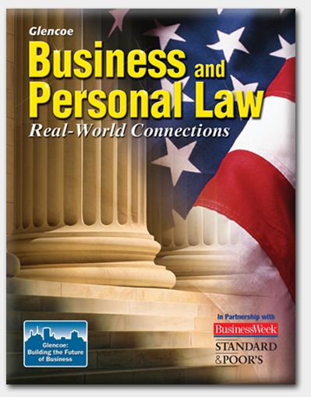
Section 14.1
Duties and Liability in Agency Relationships

Slide 5
Section 14.1 Duties and Liability in Agency Relationships
An agency relationship is a fiduciary relationship.
A fiduciary relationship is a relationship based on trust.
Notes:
All agents owe certain duties to their principals an dall principals have certain responsibilities to their agents. Julio Rodriguez, a star soccer player, has hired a sports agent. What might be some of his responsibilities toward Julio? Secure a professional contract, handle endorsements of products, loyalty to Julio, honesty in his dealings. What responsibilities might Julio have toward his agent? Compensation for services, cooperation with agent’s judgment

Slide 6
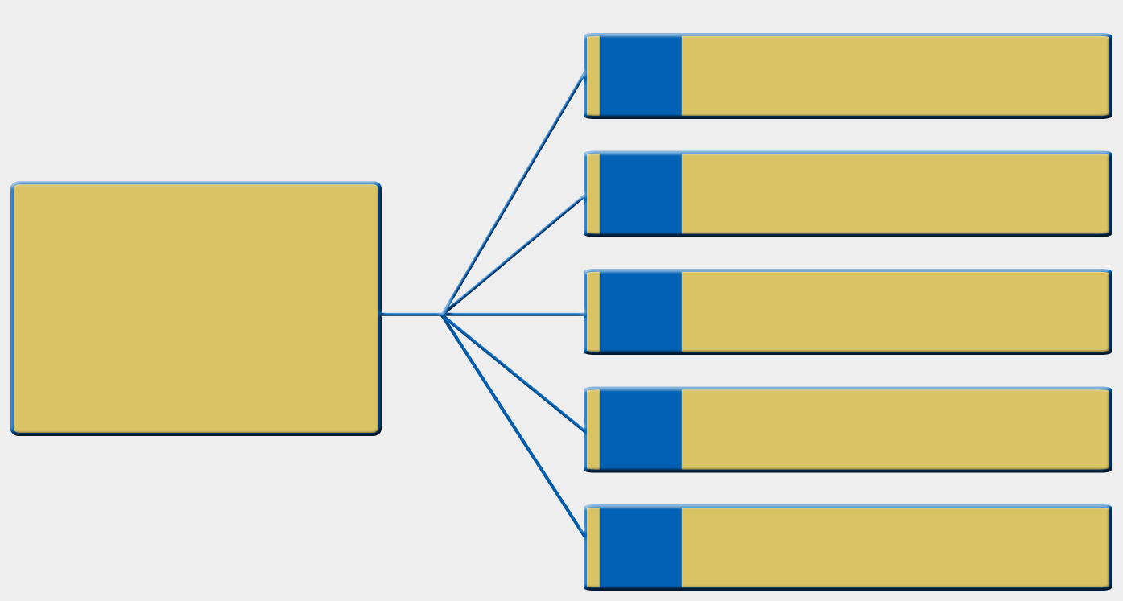
Section 14.1 Duties and Liability in Agency Relationships
1
obedience
2
good faith
An agent owes a principal five fiduciary duties:
3
loyalty
4
accounting
5
judgment
Notes:
Jack Jones works as the agent for Dee Campbell to sell her artwork to galleries. He also works for Dee’s competitor to sell the competitor’s work in the same places. Can the agent adequately serve both principals? Probably not. One principal or the other may lose opportunities by having the competitor’s artwork in the same locale; the agent benefits either way.
Universal Access: Museums often show artwork belonging to private collectors, other museums, or organized touring presentations. Describe the types of principals and agents that might be involved in such a situation. Have them identify the benefits and responsibilities for the lender and the museum in these cases. Responsibilities or museum – take care of artwork, compensate the lender, responsibilities of lender – deliver artwork as promised; benefit to museum – new art to offer to patrons; benefit to lender – prestige of having museum show art.

Slide 7
Section 14.1 Duties and Liability in Agency Relationships
Obedience means an agent must obey a principal’s reasonable instructions.
An agent is not obligated to follow illegal or immoral instructions, such as lying for a principal.

Slide 8
Section 14.1 Duties and Liability in Agency Relationships
Good faith means an agent must deal honestly with other parties and not seek personal gain or commit fraud.

Slide 9
Section 14.1 Duties and Liability in Agency Relationships
Loyalty means agents must not work for one of the principal’s competitors or make deals that benefit themselves.

Slide 10
Section 14.1 Duties and Liability in Agency Relationships
Agents have a duty to account for a principal’s money and keep it safe.
If an agent mixes his or her own personal money with the principal’s money, the entire amount legally goes to the principal.

Slide 11
Section 14.1 Duties and Liability in Agency Relationships
Agents have a duty to use good judgment in representing a principal.
Agents are not held liable, however, for honest mistakes if they have performed to the best of their ability.

Slide 12
Section 14.1 Duties and Liability in Agency Relationships
A principal owes an agent four duties:
compensation
reimbursement
indemnification
cooperation
Notes:
Agents have the right to be repaid for spending their own money on a principal’s behalf: What factors should be considered regarding whether a person should be reimbursed for gas money? Factors will vary, but may include whether the agent’s entire tank of gas was used for the principal’s behalf, whether the agent shopped for a reasonable price for fuel, why the highest grade is really necessary for the vehicle, and whether snacks and a car wash were really justified. When an agent is performing a duty for a principal, the agent is expected to exercise good faith with no intent to seek personal advantage.

Slide 13
Section 14.1 Duties and Liability in Agency Relationships
Compensation is fair pay for a job.
A principal must pay an agent the amount stated in a contract. If no amount is stated, the principal must pay the agent a reasonable amount.

Slide 14
Section 14.1 Duties and Liability in Agency Relationships
Reimbursement means the principal must pay the agent for any money the agent spent on behalf of the principal, such as transportation costs.

Slide 15
Section 14.1 Duties and Liability in Agency Relationships
Indemnification means the principal must pay the agent for any losses the agent suffered on behalf of the principal, such as damage to equipment.

Slide 16
Section 14.1 Duties and Liability in Agency Relationships
Cooperation means a principal has an obligation not to interfere with an agent and make it difficult or impossible for an agent to carry out his or her duties.

Slide 17
Section 14.1 Duties and Liability in Agency Relationships
People are usually held liable for their own actions.
When an agent acts on behalf of a principal, however, it is as if the principal has acted.
Notes:
The word indemnify means to compensate for loss. Explain why they think a principal is responsible for indemnification in agency relationship. Without indemnification, the agent would be held responsible for losses incurred due to any misrepresentation, error, or oversight of the principal. This would open the agent up to unlimited potential losses. Many contract agreements explicitly state that the agent cannot be held at fault for any claim, loss, or expense in connection with the affairs of the principal.

Slide 18
Section 14.1 Duties and Liability in Agency Relationships
Thus, if an agent causes any damage or injury while working for a principal, the principal is held liable.
If the agent, however, acted beyond his or her authority, the agent is held liable.

Slide 19
Who is liable for an injury depends on two questions:
Are the parties in a principal-agent or proprietor-independent contractor relationship?
Does the liability concern a contractual matter or a tort?

Slide 20
To determine the relationship they may ask the following questions:
Does the hiring person make available the tools for the worker?
Is the worker paid hourly?
Is the worker employed only by the hiring person?
Is the business of the worker the same as the business of the hiring person?
Does the hiring person have the authority to hire or fire others workers?
Does the hiring person supervise the tasks of the worker?
Is little skill needed to do the worker’s job?
Notes:
The more answered with “yes” the more likely it is a principal-agent relationship. If so, liability follows the rules that apply to principals and agents for contracts and torts. The more “no” answers, the more likely a proprietor-independent contractor relationship exists and liability follows the rules for this type of relationship.

Slide 21
Contractual Liability of Principals
“stand in the shoes of the principal”
Principals liable for proven injuries in contractual disputes

Slide 22
Contractual Liability of Agents
Three situations can occur in which an agent becomes liable for an injury to a third party.
The agent has made an agreement or performed tasks beyond his or her authority to do so.
The principal is a minor or does not have the capacity to sign a contract, yet the agent has not disclosed this fact to the third party.
The principal is undisclosed, and the third party cannot identify the principal
Notes:
(such as a celebrity) If the principal is undisclosed, the third party has no choice but to hold the agent liable in case of the breach of contract. If agent has negotiated an agreement beyond the scope of his or her authority, the third party holds the agent liable.

Slide 23
Contractual Liability of Independent Contractors
Independent contractors are not agents
Have no authority to make agreements or conduct business

Slide 24
Tort Liability of Principals
Vicarious Liability
Master-servant relationship
Agent acting on behalf of principal

Slide 25
Section 14.1 Duties and Liability in Agency Relationships
According to the legal doctrine of respondeat superior, a master (principal) is liable for the wrongful acts of his or her servant (agent).
Notes:
According to the doctrine of respondeat superior, a master is responsible for the torts of his or her servants. What is the reasoning behind this? Masters have the right to control the physical conduct of their servants. They are, therefore, responsible when the servant injures a third party while the servant is on the job. Can you think of examples? Publisher being responsible for a reporter’s slanderous article or a club owner being responsible for a bounder hurting a customer

Slide 26
Chapter 14 Assessment
Agency Authority and Termination

Slide 27
1. A relationship based on trust is called a:
mutual relationship
platonic relationship
fiduciary relationship
convenient relationship

Slide 28
2. An agent can work for two competing principals at the same time.
True or False

Slide 29
3. The legal doctrine that holds a principal liable for the wrongful acts of an agent is:
caveat emptor
e pluribus unum
respondeat superior
quid pro quo

Slide 30
4. When an agent acts on behalf of a principal, it is as if the principal has acted.
True or False

Slide 31
5. What is a fiduciary relationship?
6. What is the difference between reimbursement and indemnification?
7. What is the difference between negligent hiring and negligent retention?

Slide 33
Warm Up
List at least 3 agency relationships you can think of. What type of powers do each have? (ex. Real estate agent has the power to locate a home for a buyer)

