Slide 1
Learning Objective
LO4 Prepare closing entries.
© 2014 Cengage Learning. All Rights Reserved.

Slide 2
Closing Entries
Lesson 16-4
LO4
A corporation records four closing entries:
1. A closing entry for income statement accounts with credit balances (revenue and contra-cost accounts).
2. A closing entry for income statement accounts with debit balances (cost, contra revenue, and expense accounts).
3. A closing entry to record net income or net loss in the Retained Earnings account and close the Income Summary account.
4. A closing entry for the Dividends account.

Slide 3
The Income Summary Account
Lesson 16-4
LO4
Income Summary
Debit
Expenses
Credit
Revenue (greater than expenses)
(Credit balance is the net income)

Slide 4
Closing Entry for Accounts with Credit Balances
Lesson 16-4
LO4
Sales
Closing 632,371.75
Bal. 632,371.75
(New Bal. 0.00)
Interest Expense
Adj. (mdse inv.) 5,648.44
Closing 635,345.90
(credit accounts)

Slide 5
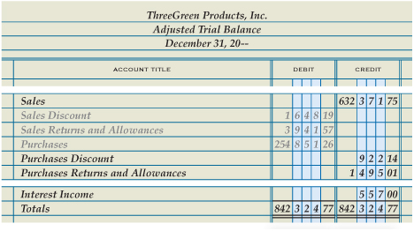
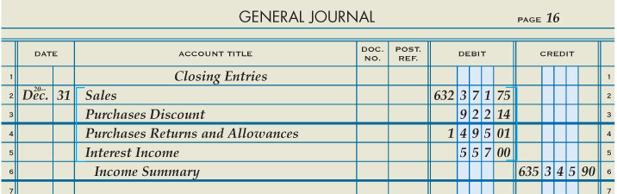
Closing Entry for Accounts with Credit Balances
Lesson 16-4
LO4
Debit to Close
3
3
2
Date
1
Heading
Credit to Income Summary
4

Slide 6
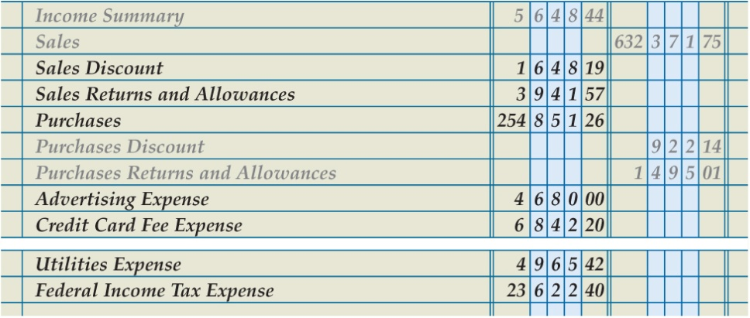
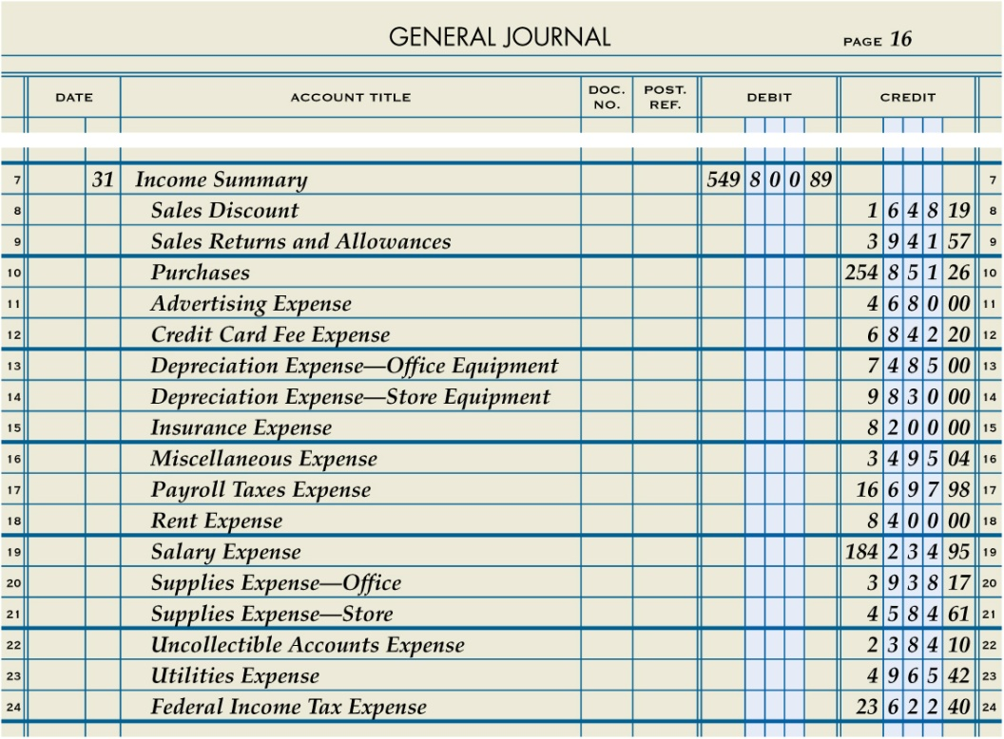
Closing Entry for Income Statement Accounts with Debit Balances
Lesson 16-4
LO4
Credit to Close
3
3
Income summary
Date
1
2
Debit to Income Summary
4

Slide 7
Summary of Closing Entry for Income Statement Accounts with Debit Balances
Lesson 16-4
LO4
Purchases
Bal. 254,851.26
(New Bal. 0.00)
Closing 254,851.26
Income Summary
Adj. (mdse. Inv.) 5,643.44
Closing (debit accounts) 549,800.89
Closing (credit accounts) 635,345.90
(New Bal. 79,896.57)

Slide 8
Closing Entry to Record Net Income
Lesson 16-4
LO4
Income Summary
Adj. (mdse. inv.) 5,643.44
Closing (debit accounts) 549,800.89
Closing (Retained Earnings) 79,896.57
Closing (credit accounts) 635,345.90
(New Bal. 0.00)
Retained Earnings
Closing (credit accounts) 65,218.84
Closing (Retained Earnings) 79,896.57
(New Bal. 145,115.41)
Date
Debit Income Summary
Credit Retained Earnings

Slide 9
Closing Entry for Dividends
Lesson 16-4
LO4
Retained Earnings
Closing (Dividends) 15,000.00
Bal. 65,218.84
Closing (Income Summary) 79,896.57
(New Bal. 130,115.41)
Dividends
Bal. 15,000.00
(New Bal. 0.00)
Closing (Retained Earnings) 15,000.00
Date
Debit Retained Earnings
Credit Dividends

Slide 10
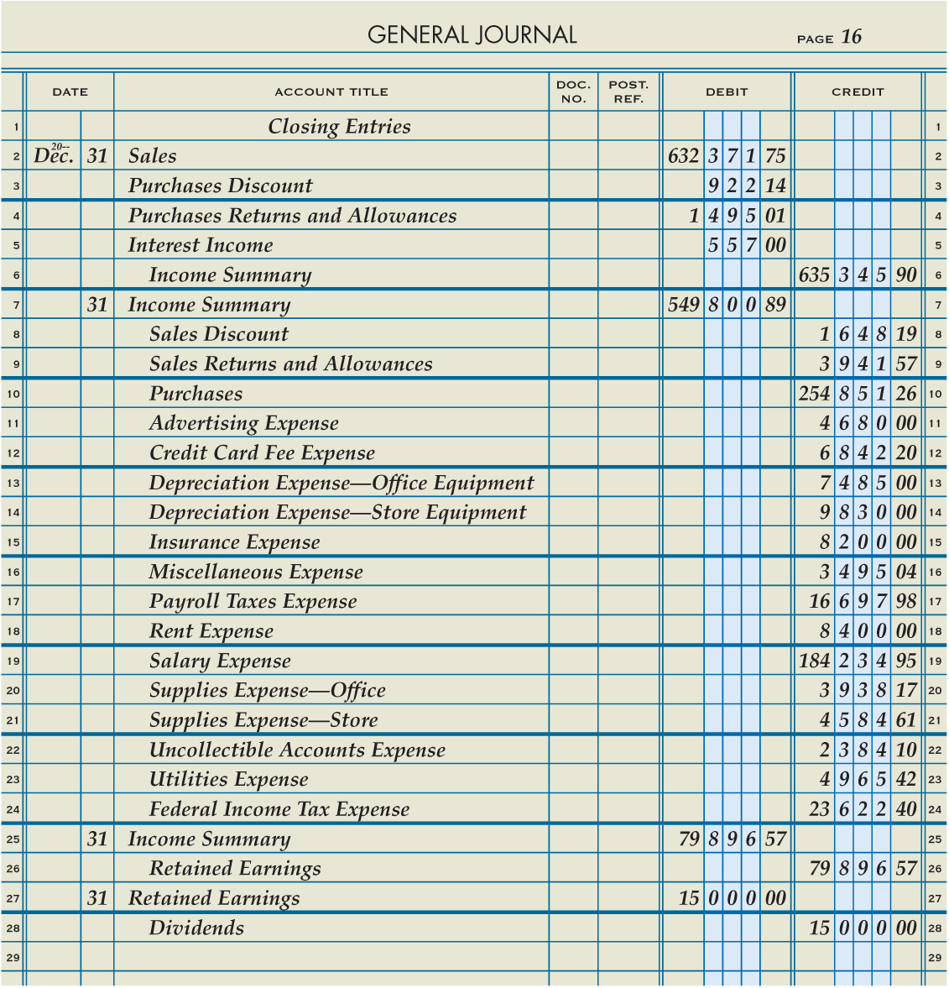
Completed Closing Entries for a Corporation Recorded in a Journal
Lesson 16-4
LO4

Slide 11
Work Together 16-4
Journalizing closing entries
Use Superior Corporation's trial balance and financial statements from Work Together 16-3. A general journal is given in the Working Papers. Your instructor will guide you through the following example.
Record the following closing entries on page 19 of the general journal.
Close the income statement accounts with credit balances.
Close the income statement accounts with debit balances.
Close the Income Summary account.
Close the Dividends account.

Slide 12
Close the income statement accounts with credit balances

Slide 13
Close the income statement accounts with debit balances

Slide 14
Close the Income Summary account

Slide 15
Close the Dividends account

