Slide 1
Notes:
Can you remember what the elements that make a contract valid?
Offer, capacity, legality, acceptance, consideration, genuine agreement
When the elements of genuine agreement is no longer included, a contract becomes defective. This section will cover all the circumstances under which a contract becomes defective.
Victims of Fraud: Anybody can become a victim of fraud. Why do unscrupulous telemarketers often target retired Americans for fraud? Retired people are more likely to have substantial savings and investments, to be at home to receive phone calls, and to listen respectfully to a sales pitch.
For these victims there are financial effects of these frauds: the majority lost money or property and a lesser percent suffered credit problems and health problems, and lost time off work. Psychological effects: self-doubt, shock, societal indifference, isolation, anger, resentment, frustration with criminal justice professionals, shame, embarrassment, fear for financial security, increased concern about personal safety and well-being.

Slide 2
What You’ll Learn
Differentiate among the ways contracts can be undermined (fraud, non-disclosure, misrepresentation, mistake, duress, and undue influence)
Explain what remedies are available when contract is not fulfilled.
Knowing the consequences of a breach of contract can help you prepare for the loss that follows and for deciding on possible recourse.

Slide 3
Key Terms
Academic Terms
Fraud
Duress
Undue influence
Remedy
Damages
Punitive damages
injunction
Intent
Exaggerate
mutual

Slide 4
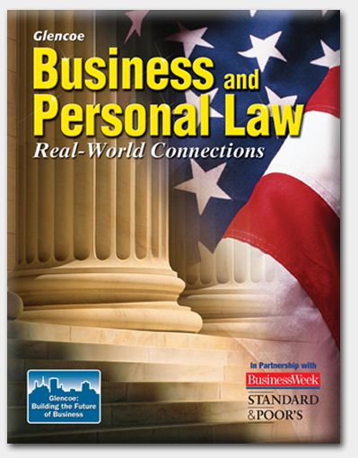
Section 6.2
Voidable Contracts and Remedies
Notes:
Cyberlaw: BellSouth communications System, LLC v. West
BellSouth is an Internet Service provider in Alabama, where Thomas West resides, In 2002, Mr. West signed up with BellSouth for Internet services. The advertised price was $15.95 per month. When Mr. West received his bill from BellSouth, he discovered he had been charged $19.85 for one month’s service and a $15.00 set-up fee. Mr. West sued for breach of contract. BellSouth countered arguing that the membership agreement that Mr. West had signed said that BellSouth could change any terms of the agreement (including the monthly fee) by posting notice on the Internet. Mr. West said he never saw the posting.
Ruling and Resolution: The Alabama Supreme Court held that BellSouth could not provide proof of when it had posted the change in fees on its Web site. Neither could BellSouth prove that Mr. West had accessed the Web site after the alleged change. Therefore, Mr. West was able to recover damages against BellSouth.
Should companies be allowed to notify customer of changes to their contracts by posting notices on Web sites? The courts have held that posting notices on Web sites if adequate notification to consumers that terms of contract have changed. Some companies require customer to agree to notification by posting, but it is not required in most circumstances. It is presumed that customers keep themselves aware of such notices by regularly checking postings.

Slide 5
Section 6.2 Voidable Contracts and Remedies
A contract that seems to be valid can be voided if the agreement is defective.

Slide 6
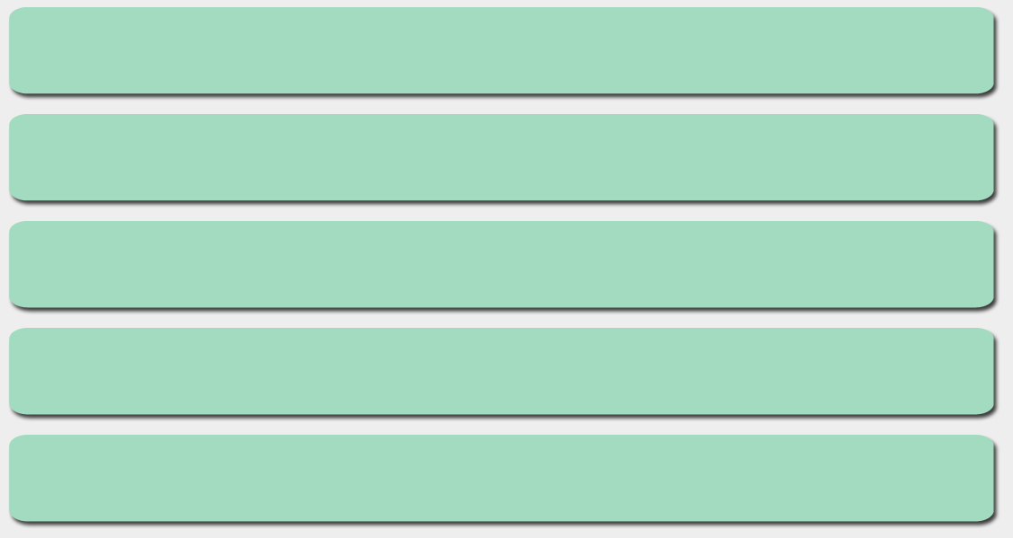
Section 6.2 Voidable Contracts and Remedies
A contract may be defective due to:
fraud
misrepresentation
mistake
duress
undue influence
Notes:
False Representations: if I put a cell phone in front of the class and tell you that the phone will never drop calls and is 100 percent reliable. What kids of misrepresentations have I made? Never drops calls, 100 percent reliability Consumers might make decisions to buy the phone based on this representation. In a fraud case, the injured party must prove that he or she depended on the lie.
Example: Jeff purchased a used car from Quality Autos. The salesperson at the lot assured Jeff that his car had never been involved in an accident. While looking through his car’s glove box a week after purchasing it, Jeff discovered repair receipts that indicated the car had been in a major accident. Can Jeff pursue a claim of false representation? Yes. He would have to prove either that the salesperson knew of the car accident or that he made a reckless statement about the car’s history and condition.

Slide 7
Section 6.2 Voidable Contracts and Remedies
Fraud is a deliberate deception designed to gain something unfairly and unlawfully.
Notes:
To win a lawsuit based on fraud, five elements must be shown:
There must be a false representation of fact (a lie) – sales people are allowed to exaggerate their claims as long as it is obvious the seller’s opinion
The person who lied must know it was a lie -
The lie must be made with the intent that it will be relied on – the other party would hear it, believe it, and act on it
The innocent party must reasonably rely on the lie
The innocent party must experience a loss -

Slide 8
Section 6.2 Voidable Contracts and Remedies
Misrepresentation occurs when a person unintentionally claims something that turns out to be false.
Notes:
Innocent Misrepresentation: a salesman at a dealership routinely tells customers that a certain brand of truck is the most durable on the market. That salesman later discovers that the brand has the worst record for durability. Should the salesman have to notify the people he sold to and nullify their sales contracts? Innocent party can get out of the contract
Mistake, Duress, and Undue influence – that an individual’s free will may be disrupted by the undue influence of someone upon who they depend. Why is under influence difficult to prove? Difficult to prove when the line has been crossed between mere influence and excessive pressure; evidence is scarce and difficult to obtain; and the dependent party may really believe that he or she is getting a great benefit from the independent party.

Slide 9
Section 6.2 Voidable Contracts and Remedies
A mistake is an error made in a contract.
The mistake can be unilateral or bilateral.

Slide 10
Section 6.2 Voidable Contracts and Remedies
A unilateral mistake is a mistake made by one of the parties to a contract.
When this happens, the party usually cannot get out of the contract.
Notes:
Unilateral Mistake: if you mistakenly buy a CD you already own, you cannot simply negate the contract. What can you do to avoid this situation? When you buy an item and you need to return it to the store, ensure that the seller’s contract includes a return policy before you buy.

Slide 11
Section 6.2 Voidable Contracts and Remedies
A bilateral mistake is a mistake by both parties to a contract.
When this happens, usually either party can get out of the contract.
Notes:
One way to tell the difference between a unilateral and bilateral mistake is to look at the words. “uni” is a Latin prefix that means one, and “bi” is a Latin prefix that means two. If both parties in a contract make mistakes, either party can usually void the contract. Can you think of examples why people can get out of a contract due to bilateral mistake. Obligation cannot be performed, subject matter of contract was not clear.

Slide 12
Section 6.2 Voidable Contracts and Remedies
Duress occurs when someone uses force or the threat of force to get someone else to enter into a contract.
Notes:
There is Physical Duress – actual physical force is used to make a contract happen. The contract is void.
Economic Duress – threatens a persons business or income an person must prove three things:
The other party wrongfully placed them in poor economic position
The victim had no choice other than to submit to the duress
The submission to the duress was reasonable under the circumstances

Slide 13
Section 6.2 Voidable Contracts and Remedies
Undue influence occurs when someone uses a position of power over someone else to persuade that person to enter into a contract.
Notes:
To succeed in voiding a contract based on undue influence, the victim has to prove three things:
the existence of a caregiver-type relationship
The use of excessive pressure by the caregiver
A resulting contract that heavily favors the caregiver

Slide 14
Section 6.2 Voidable Contracts and Remedies
When a contract has been breached, the injured party can seek a remedy.
A remedy is a legal means of enforcing a right or correcting a wrong.
Notes:
Remedies: When a contract is breached, the injured party has a choice of remedies. What do you think of when you here the word remedy? Medicine to help an ailment how do you think remedy works when it comes to contracts? Legal means of enforcing a right or correcting a wrong the injured party has three options:
Accept the breach
Sue for money damages
Ask court for an equitable remedy (in some case)
Have you ever had a friend promise to take you somewhere and then does not? Have you suffered any actual damages? While missing the experience of the event could be considered a damage, no real damage was inflicted.

Slide 15
Section 6.2 Voidable Contracts and Remedies
The injured party can sue for damages or ask the court for an equitable remedy.
Damages are usually in the form of money.
An equitable remedy usually consists of requiring the other party to complete the contract.
Notes:
Refer to the figure 6.2 print out from teacher.
Suing for money damages is one remedy for breach of contract. What is the objective of awarding damages to the injured party in a contract case? The objective of damages in contact law is the place the injured party in a good a position as he or she would have been in had the contract been performed as originally promised.
Some parties to a contract, rather than leaving the determination of damages to a court, may agree in advance what the damages will be in the event that one of them breaches the contract (known as liquidated damages). Can you think of a contract situation in which such liquidated damages would be important? Substantial loss of profits to either party.
Remedies: example – Prime Company was contracted to deliver 200 gallons of fruit to the J Jam Company. Prime delivered 150 gallons due to a planning mistake. What kind of remedies are available to J Jam Company? Money damages, request the Prime find another company to deliver remaining 50 gallons.

Slide 16
Chapter 6 Assessment
How Contracts Come to an End

Slide 17
1. A unilateral mistake is a mistake made by both parties to a contract.
True or False

Slide 18
2. Using force or the threat of force to get someone to enter into a contract is:
fraud
misrepresentation
duress
undue influence

Slide 19
3. What are the elements of fraud?
4. What are the different remedies for fraud and misrepresentation?
5. What are the requirements of undue influence?

Slide 21
Warm Up
Debra agreed to work for Lupe for two years. At the end of the two months, Debra went to Lupe and asked to be released from her contract. Lupe agreed. Was the contract discharged? explain
Notes:
Yes. Under the theory of mutual release, if both parties agree, then the contract ends.

