Slide 1
Notes:
What do you think it means when someone says “Let the seller beware?” manufactures and sellers are held accountable for the products they produce and sell, and therefor must use care when selling and producing products

Slide 2
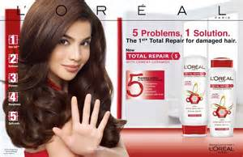
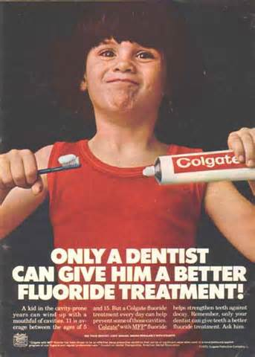
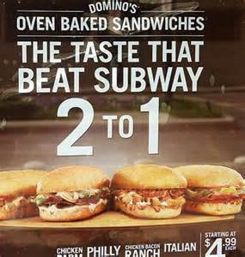
Notes:
Look at the claims made on these ads. Would these claims influence your decision to buy?
If they did not meet there claims what would you do?
Back in chapter 1 we discussed ethics (moral principles as of an individual or business). What might be the consequences a business might suffer if it engages in unethical and deceptive practices? Compromised brand or image, tarnished reputation. Loss of business, failed consumer confidence, and lawsuits.
Have you ever had a problem with something you bought that does not work or live up to your expectations? How do you decide whether federal or state safety laws apply? Federal product safety laws concern products sold in more than one state. For products sold or manufactured within one state, the state’s product liability laws would apply.
Companies that distribute consumer products subject to provisions of the Federal Hazardous Substance Act (FHSA), Flammable Fabrics Act (FFA), and Poison Prevention Packaging Act (PPPA) must also comply with the Consumer Product Safety Act. If a company has knowledge of product safety issues, the company is required to report this information to the US Consumer Product Safety Commission within five days. Why do you think it is so important to make this happen quickly? Consumer safety is at risk, recalls might be necessary

Slide 3
What You’ll Learn
Distinguish different types of consumer fraud
Describe laws and agencies that protect consumers
Identify various types of warranties
Describe how warranties may be excluded or modified
Determine where to get consumer protection assistance
Knowing about warranties and consumer protection laws will help you if you ever buy a faulty product.

Slide 4
Key Words
Academic Vocabulary
Warranty
Express warranty
Full warranty
Limited warranty
Implied warranty
Warranty of merchantability
Warranty of fitness for a particular purpose
Disclose
Option
Exclude

Slide 5
Section 7.2
Consumer Protection

Slide 6
Section 7.2 Consumer Protection
The federal and state governments have laws to protect consumers from unsafe products and unfair business practices.
Notes:
Federal Consumer Protection Law:
Consumer Product Safety Act – protects you form unreasonable risk of injury while using consumer products sold in interstate commerce.
Consumer Leasing Act – requires lease agreements to include certain terms of the lease, including the requirement numbers of lease payments and their dollar amounts. And may include penalties for late payments.
Sate and Local Laws – for intrastate commerce
Unfair and Deceptive Practices
Fraudulent Misrepresentation – any statement that deceives a buyer, buy misleading or fails to disclose the facts
Bait and Switch Advertising –

Slide 7
Section 7.2 Consumer Protection
The federal government passes laws that regulate interstate commerce, or business that crosses state lines.
The federal agency that regulates business is the Federal Trade Commission (FTC).
Notes:
There was a time when you could join a program that would send you something each month. Such as a music CD, a Christmas ornament, or a book for a child. The idea is that you will continue to order/pay these products (1) because it is too much trouble to return and (2) by you listening/seeing the item you will like it. The seller must provide its requirements (how many a month you have to buy), how to cancel membership, how to refuse the selection of the month, how to get credit for returning a selection, how postage is charged, how forms and announcements are received.
FTC Trade Regulation Rules
Negative Option Rule – example: monthly subscriptions for CDs, the company must sent you a description and if you do not want it you have to tell them. Such as sending the notifying post card back.
The Cooling-off Rule – 3 business days to cancel a transaction made away from the seller.
Telemarketing Sales Rule – if you ask telemarketers to not call you they have to abide by that and can only call between 8am and 9 pm, must tell you this is a sale call and must give you the total price of something.
Shopping by Mail, Phone, Fax, or Internet – must ship goods by the time they state and if not stated must be within 30 days.
Example: Business Ethics – You run a small bookstore that is expanding its Internet business. You know that Yolanda Price is due to release her new book next month, and everyone will want to buy it. You decide to advertise the book cheaper than your local rivals. On the Web site, you state that if people pre-order the book from your company, you will deliver the book “as soon as possible after it is published,” even though you know that your supplier will deliver the book to you one week after it delivers the book to the bigger bookstores. Should you change your claim on the Web site? The FTC has regulations that require companies to send products ordered over the Internet in the time provided on the Web site. If no specific time is listed, then sellers must send the product within 30 days after receiving the order. The advertisement in question does not list a specific time period, so your company would be required to send the product within 30 days of receiving an order.

Slide 8
Section 7.2 Consumer Protection
Each state government passes laws that regulate intrastate commerce, or business that occurs within the state.
Most states have their own Department of Consumer Affairs to regulate business.
Notes:
Why do you think consumer protection laws are important to our society? Helps keep sellers more honest and motivates buyers to continue making purchases.

Slide 9
Section 7.2 Consumer Protection
Both federal and state laws protect consumers from various forms of sales fraud, such as bait and switch.

Slide 10
Section 7.2 Consumer Protection
Bait and switch is when a business lures you into a store with a great bargain that doesn’t really exist, and then tries to sell you something else more expensive.
Notes:
Examples of Bait & Switch Advertising
by George N. Root III, Demand Media
Bait and switch advertising is when a company offers consumers an appealing deal and then changes the deal when consumers make direct inquiries. The Federal Trade Commission monitors advertising, and has laws in place that prohibit advertisers from using deceptive advertising and that require them to have proof to back up claims. But there are still plenty of examples of bait and switch advertising that consumers need to watch for.
One of a Kind
One of the more common examples of a bait and switch sales tactic is when used car dealerships advertise extremely low prices on vehicles for which they have a very limited number in stock. You might see an advertisement for a car you would like at a price you can afford, but when you get to the dealership the car is already sold. In this case, the dealer will offer to show you other vehicles you might be interested in. This is technically legal because the dealership did have at least one such car in stock, and it is possible that the one vehicle was already promised to another customer when it was advertised. By the time other interested consumers arrive, the advertised vehicle is gone and the bait and switch is on.
While Supplies Last
One bait and switch technique that retailers use is to offer a free accessory with a popular product to drive foot traffic to the store. For example, a retail store may offer a free ink cartridge for each printer sold while supplies of the cartridge last. But the supplies are limited and are gone by the time a majority of the consumers arrive at the store. In lieu of giving you a free cartridge, the store will try to sell you one instead. This is an example of how retail stores use limited supply specials as a bait and switch.

Slide 11
Section 7.2 Consumer Protection
An important form of protection consumers have in a sales contract is a warranty.
A warranty is a guarantee by a seller to the buyer that a product will perform as promised.
Notes:
It is a promise, statement, or other representation that a thing has certain qualities. Do you think warranties help improve product quality? Since manufactures must repair any broken or ineffective products under a warranty, they are likely to make a better quality product. Manufactures and sellers offer warranties as an incentive to buy their products.
Why do you think the designs and labeling that go on product packages are so important? Since photos and labels are considered a description or sample of goods, these are express warranties.

Slide 12
Section 7.2 Consumer Protection
express
There are two basic types of warranties
implied
Notes:
Express warranties:
Statement of fact or promise – is created when a private party or a merchant sells goods and makes a statement of fact or a promise about the goods to the buyer.
Description or sample of goods – the seller warrants that the goods will be the same as the description or sample
Advertising express warranties – seller must tell you how to get a copy of the warranty
Magnuson-moss warranty act – the warranty on interstate commerce costing more than $10 must disclose whether full or limited warranties
Implied Warranties – warranty imposed by law
Merchantability – a guarantee that it is what it says such as a food item must be edible and tasteful
Fitness for a particular purpose – fit for a specific use

Slide 13
Section 7.2 Consumer Protection
An express warranty is a statement, promise, or representation made by the seller about the quality of a product.
An implied warranty is a guarantee required by law.
Notes:
Express warranty can be expressed or stated in one of three ways: statement of fact, description of goods, or by use of a sample or model.
The formal words such as warranty and guarantee do not have to be used to create an express warranty; even using those words does not mean a warranty is created. If the seller’s language is a statement of fact or a promise about the goods and is part of the transaction, an express warranty is created.
Most consumer purchases are covered by a warranty, even when it is not explicitly stated as such. The two main types are express and implied warranties. An express warranty is one that is clearly stated (or "expressed") either verbally or in writing, while an implied warranty automatically covers most consumer goods valued over a certain amount, but only provides a base level of protection for consumers.
What is the difference between express and implied warranties: express makes specific promises regarding the quality of product, while implied is a guarantee of quality imposed by law.

Slide 14
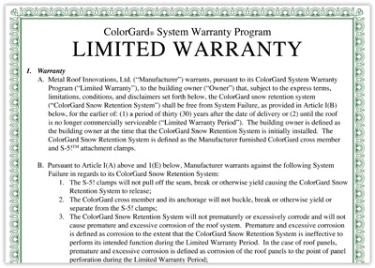
Section 7.2 Consumer Protection
A written warranty may be either
a full warranty
a limited warranty

Slide 15
Section 7.2 Consumer Protection
A full warranty is a guarantee that a defective product will be repaired or replaced without charge within a reasonable period of time.
Notes:
Full warranties usually have some conditions involved such as you have to pay for the shipping or is null and void if you open it up, something like a computer or printer.

Slide 16
Section 7.2 Consumer Protection
A limited warranty is a warranty that has certain limitations and does not provide the coverage of a full warranty.
A limited warranty might cover only parts and not labor.
Notes:
Other types of warranties:
Warranty of title – example: Randall purchased a camera from his friend Zach, which included a warranty of title. He tells his mother that this warranty will cover any defects he discovers in the camera for 90 days. Is this true? No. coverage or product quality or performance is not included in a warranty of title
Exclusion of warranties – example: Northern Attachments exclusion of Warranties
With respect to the products sold to the purchaser, Northern Attachments makes no warranty whatsoever, express or implied, including but not limited to, any warranty of merchantability or warranty of fitness for any particular purpose.
The manufacturer provides a LIMITED WARRANTY, which will be provided upon request.
Responsibilities of consumers – you must use product safely and what it is intended for

Slide 17
Chapter 7 Assessment
Consumer Law and Contracts

Slide 18
1. Business that crosses state lines is called:
intrastate commerce
interstate commerce
the Federal Trade Commission
The Department of Consumer Affairs

Slide 19
2. A warranty is a guarantee by a buyer to a seller.
True or False

Slide 20
3. A warranty that covers parts but not labor is a(n):
express warranty
implied warranty
full warranty
limited warranty

Slide 21
4. What is the cooling-off rule?
5. What are the three ways an express warranty can be made?
6. What is the warrant of title?

Slide 23
Warm Up
Bait and switch is an old gimmick unethical businesses use to lure people into a store then get them to spend more money that they intended.
Why do you think they call it bait and switch?
Can you give an example you have heard of?

