Slide 1

Notes:
In Chapter 8, you will learn about the rights and responsibilities associated with personal property. The law of patents, trademarks, and copyrights is highlighted, along with the study of bailments.
Have you ever downloaded a piece of music from the Internet? Or borrowed a piece of software from a friend? These kinds of property are usually protected under copyrights or patents.
What are different types of personal property? Think about things around your home.
Intellectual Property: Patents, trademarks, and copyrights protect one’s creative ideas from being stolen. What are some examples of intellectual property? Patents, copyrights, trademarks, logos, inventions, and works of art. Intellectual property is an original work fixed in a tangible medium of expression.
Legal Basics: Issues often arise between individuals or companies surrounding real property and intangible property. Properties might be stolen, borrowed, lost, or abandoned, and the law can help resolve these situation.

Slide 2
What You’ll Learn
Distinguish between real property, personal property, and fixtures.
Describe the different types of co-ownership of personal property.
Explain the concept of intellectual property
Give examples of intellectual property
Define the laws of patents, copyrights, and trademarks
Knowing the law about personal property will help you protect your possessions.

Slide 3
Key Words
Academic Vocabulary
Personal Property
Intellectual property
Patent
Copyright
trademark
Tangible
Exclusive
Downloading

Slide 4
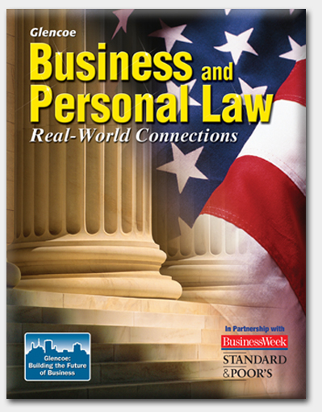
Section 8.1
Types of Property

Slide 5
Section 8.1 Types of Property
Personal property is anything that can be owned, other than real estate.
Real estate, or real property, is land and anything attached to it, such as a house and trees.
Notes:
There are two kinds of personal property; Tangible or intangible.
Tangible property is what you can touch.
Intangible property relates to a right.
Example: You spend 9 months to a year creating a video game, do you think you should have the rights to it? What if someone stole the game and then sold it, should it be that persons or yours? Co-ownership of Personal Property – if Joe and Brenda own a condo as joint tenants (A type of ownership of real or Personal Property by two or more persons in which each owns an undivided interest in the whole). What could happen with the condo if Joe where to die? Joe’s share passes to Brenda . What would be different if the two owned the property as tenants in common (A form of concurrent ownership of real property in which two or more persons possess the property simultaneously; it can be created by deed, will, or operation of law.)? Joe’s share would pass to Joe’s heirs. The distinction would be important when two people decide how they will share ownership of property.

Slide 6

Section 8.1 Types of Property
Most personal property is acquired by:
purchasing it
receiving it as a gift
inheriting
it

Slide 7
Section 8.1 Types of Property
If you find lost, misplaced, or abandoned property, you have a duty to find the owner.
If you cannot find the owner, you may be able to keep it.
Notes:
Misplaced property: If you find a cell phone on a table at a restaurant, it would be considered misplaced rather than lost. What should be done with the cell phone? Leave it with the restaurant management or owner.
Unclaimed Property Rules and Time Limits for Virginia
In Virginia, all things relating to unclaimed property are handled by the Unclaimed Property Division of the Virginia Department of the Treasury.
As a business owner, this will be the agency to contact if you possess unclaimed property (unpaid wages, for example). Remember that you are subject to both reporting requirements and the obligation to turn over abandoned property to the state.
It is also the point of contact if you believe that you may have knowingly, or unknowingly, abandoned property (for example, failing to get back a security deposit, didn't receive a tax refund).
Virginia businesses have a number of responsibilities concerning unclaimed property. Initially, written notice must be sent to the apparent owner of the unclaimed property, if known. If the property remains unclaimed, businesses have a number of filing and reporting requirements to fulfill. Most importantly, businesses are required to turn over any and all unclaimed property to the state. Stiff penalties apply to businesses who fail to comply with any of these requirements.
Individuals should know that Virginia property is generally presumed abandoned if it has remained unclaimed by the owner for more than five years after it became payable or distributable. However, this time limit varies depending on the type of property involved. Once abandoned property is turned over to the state by a business, an individual then has the burden of reclaiming it from the state.
Reporting Unclaimed Property in Virginia
In Virginia, information reports are required of persons holding property which has reverted to the Commonwealth by reason of a presumption of abandonment. The report is made to the State Treasurer and is due before November 1 for each year ending as of the preceding June 30. Insurance companies file by May 1 of each year ending as of the preceding December 31.
The report requires identification of the property and its former owner and dates when the property became payable and when the last transaction with the owner occurred.
Reports containing 25 or more items must be remitted in an electronic format unless the Treasurer determines that the requirement would create an undue hardship. In order to use Virginia's electronic reporting system, you must: e-mail. the Treasurer with your name, your company's name and its Federal Identification Number to register. Once your registration information has been verified, a username and password will be e-mailed back to you. After logging in for the first time, you will be required to update your company and contact information. You will then be allowed to transfer your report directly from your computer to the Treasurer's database.
Prior notice to owner. A holder :is generally required to exercise due diligence prior to the submission of the unclaimed property report when the property has a value of $100 or more. To fulfill this requirement, a holder must send a first-class mailing to the owner's last known address informing them of the dormant status of the property.
Delivery. Property reported as unclaimed is delivered to the State Treasurer at the same time as the report is filed.
Recordkeeping. A business must generally maintain related records five years after the unclaimed property is reported. However, where no report is filed, the time period is 10 years after the property becomes reportable. Also, the period is three years for traveler's checks, money orders, and similar financial instruments.
Penalties. a holder is required to pay interest and a civil penalty up to $1,000 for each day the report and remittance is withheld up to a maximum of the lesser of $50,000 or 100 percent of the value of the property which should have been paid or delivered and shall be required to pay interest at the same annual rate as is applicable to delinquent taxes.
Claiming Unclaimed Property in Virginia
In Virginia, property is generally presumed abandoned if it has remained unclaimed by the owner for more than five years after it became payable or distributable. However, this time limit varies depending on the type of property involved. Once abandoned property is turned over to the state by a business, an individual then has the burden of reclaiming it from the state.
Locating abandoned property held by the state. Unclaimed property held by the state may be found by searching the state's website (https://www.trs.virginia.gov/vaMoneySearch/Account/LogOn).
To find out if other states may be holding your unclaimed property, search the national database established by the National Association of Unclaimed Property Administrators (NAUPA).
Filing a claim. Claims for recovery of abandoned property are made to the Virginia State Treasurer. The Treasurer's office will notify the claimant in writing of the outcome of their claim.
To start the recovery process, fill out a state claim inquiry form available online (https://www.trs.virginia.gov/vaMoneySearch/Account/LogOn) after performing a successful search. You can also skip the property search and go directly to the Unclaimed Property Inquiry Form (https://www.trs.virginia.gov/vaMoneySearch/Account/LogOn). The Treasurer will contact you with how to proceed from there.
The Treasurer is authorized to deduct costs of notices, sales, and other related expenses incurred in the administration of unclaimed property, while in the Treasurer's custody, when paying a claim to the rightful owner.
A person dissatisfied with a decision of the Treasurer may bring an action to establish the claim within 90 days in the circuit or corporation court of the county or city in which the property is located.
Virginia Unclaimed Property Resources
If you're looking for additional information on unclaimed property, we recommend contacting your state's governmental agency that oversees the administration of this area of the law. For help in answering a specific unclaimed property question in Virginia, contact the following:

Slide 8
Section 8.1 Types of Property
You do not have a right to keep stolen property even if you did not know it was stolen.
Title to stolen property never leaves the rightful owner.

Slide 9
Section 8.1 Types of Property
A special class of personal property is intellectual property.

Slide 10
Section 8.1 Types of Property
Intellectual property is an original work fixed in a tangible medium of expression, such as an image, an object, or writing.
Notes:
A claim to intellectual property, such as a patent or trademark ensures that the owner retains rights to his or her creation. What might happen if individuals did not have the right to their intellectual property? Motivation to create could be impaired.
June 20, 2014 The patent office goes out of bounds in Redskins trademark case
The decision this past week by the U.S. Patent and Trademark Office to rescind federal trademark protections for the Redskins may ultimately tip the balance in the controversy over the 80-year-old name of Washington’s football team. If so, that would be a shame. Not because there’s insufficient reason to consider the name “disparaging to Native Americans,” as the patent office determined. Many of us recoil at the reference to skin color as a team identity. The problem is that the Redskins case is just the latest example of a federal agency going beyond its brief to inappropriately insert itself in social or political debates.
Few people would have expected the future of the Redskins to be determined by an obscure panel in a relatively small government agency. Yet the Trademark Trial and Appeal Board showed little restraint in launching itself into this heated argument — issuing an opinion that supports calls for change from powerful politicians, including President Obama and Senate Majority Leader Harry Reid (D-Nev.). The board had at its disposal a ridiculously ambiguous standard that allows the denial of a trademark if it “may disparage” a “substantial composite” of a group at the time the trademark is registered.
This standard isn’t concerned with how widely offensive a trademark may be now, or with how the general population or even a majority of the group in question views it. It didn’t matter to the patent office that polls show substantial majorities of the public and the Native American community do not find the name offensive. A 2004 Annenberg Public Policy Center poll found that 90 percent of Native Americans said the name didn’t bother them. Instead, the board focused on a 1993 resolution adopted by the National Congress of American Indians denouncing the name. The board simply extrapolated that, since the National Congress represented about 30 percent of Native Americans, one out of every three Native Americans found it offensive. “Thirty percent is without doubt a substantial composite,” the board wrote.
Politicians rejoiced in the government intervention, which had an immediate symbolic impact. As Sen. Maria Cantwell (D-Wash.) said Wednesday: “You want to ignore millions of Native Americans? Well, it’s pretty hard to say the federal government doesn’t know what they’re talking about when they say it’s disparaging.”
For the Washington Redskins, there may be years of appeals, and pending a final decision, the trademarks will remain enforceable. But if the ruling stands, it will threaten billions of dollars in merchandizing and sponsorship profits for NFL teams, which share revenue. Redskins owner Dan Snyder would have to yield or slowly succumb to death by a thousand infringement paper cuts.
The patent office opinion also seems to leave the future of trademarks largely dependent on whether groups file challenges. Currently trademarked slogans such as “Uppity Negro” and “You Can’t Make A Housewife Out Of A Whore” could lose their protections, despite the social and political meaning they hold for their creators. We could see organizations struggle to recast themselves so they are less likely to attract the ire of litigious groups — the way Carthage College changed its sports teams’ nickname from Redmen to Red Men and the California State University at Stanislaus Warriors dropped their Native American mascot and logo in favor of the Roman warrior Titus. It appears Fighting Romans are not offensive, but Fighting Sioux are.
As federal agencies have grown in size and scope, they have increasingly viewed their regulatory functions as powers to reward or punish citizens and groups. The Internal Revenue Service offers another good example. Like the patent office, it was created for a relatively narrow function: tax collection. Yet the agency also determines which groups don’t have to pay taxes. Historically, the IRS adopted a neutral rule that avoided not-for-profit determinations based on the content of organizations’ beliefs and practices. Then, in 1970, came the Bob Jones University case. The IRS withdrew the tax-exempt status from the religious institution because of its rule against interracial dating on campus. The Supreme Court affirmed in 1983 that the IRS could yank tax exemption whenever it decided that an organization is behaving “contrary to established public policy” — whatever that public policy may be. Bob Jones had to choose between financial ruin and conforming its religious practices. It did the latter.
There is an obvious problem when the sanctioning of free exercise of religion or speech becomes a matter of discretionary agency action. And it goes beyond trademarks and taxes. Consider the Federal Election Commission’s claim of authority to sit in judgment of whether a film is a prohibited “electioneering communication.” While the anti-George W. Bush film “Fahrenheit 9/11” was not treated as such in 2004, the anti-Clinton “Hillary: The Movie” was barred by the FEC in 2008. The agency appeared Caesar-like in its approval and disapproval — authority that was curtailed in 2010 by the Supreme Court’s decision in Citizens United.
Even water has become a vehicle for federal agency overreach. Recently, the Obama administration took punitive agency action against Washington state and Colorado for legalizing marijuana possession and sales. While the administration said it would not enforce criminal drug laws against marijuana growers — gaining points among the increasing number of citizens who support legalization and the right of states to pass such laws — it used a little-known agency, the U.S. Bureau of Reclamation, to cut off water to those farms. The Bureau of Reclamation was created as a neutral supplier of water and a manager of water projects out West, not an agency that would open or close a valve to punish noncompliant states.
When agencies engage in content-based speech regulation, it’s more than the usual issue of “mission creep.” As I’ve written before in these pages, agencies now represent something like a fourth branch in our government — an array of departments and offices that exercise responsibilities once dedicated exclusively to the judicial and legislative branches. Insulated from participatory politics and accountability, these agencies can shape political and social decision-making. To paraphrase Clausewitz, water, taxes and even trademarks appear to have become the continuation of politics by other means.
What is needed is a new law returning these agencies to their core regulatory responsibilities and requiring speech neutrality in enforcement. We do not need faceless federal officials to become arbiters of our social controversies. There are valid objections to the Redskins name, but it is a public controversy that demands a public resolution, not a bureaucratic one.
The U.S. Patent and Trademark Office has canceled the Washington Redskins’ trademark. Federal trademark law does not permit registration of trademarks that "may disparage" individuals or groups.
The U.S. Patent and Trademark Office canceled the Washington Redskins’ trademark registration on Wednesday, a move that won’t force the NFL team to change its name but fuels the intense fight by opponents to eliminate what they view as a racial slur against Native Americans.
The 99-page decision by the Trademark Trial and Appeal Board said the team’s name and logo are disparaging. It dilutes the Redskins’ legal protection against infringement and hinders the team’s ability to block counterfeit merchandise from entering the country.
But its effect is largely symbolic. The ruling cannot stop the team from selling T-shirts, beer glasses and license-plate holders with the moniker or keep the team from trying to defend itself against others who try to profit from the logo. And the trademark registrations will remain effective during any appeal process.
The ruling’s main impact is as a cudgel by an increasingly vocal group of Native Americans, lawmakers, former players and others who are trying to persuade team officials to change the name. The backlash against the name has never been more intense.
The U.S. Patent and Trademark Office canceled the Washington Redskins’ trademark registration on Wednesday, a move that won’t force the NFL team to change its name but fuels the intense fight by opponents to eliminate what they view as a racial slur against Native Americans.
The 99-page decision by the Trademark Trial and Appeal Board said the team’s name and logo are disparaging. It dilutes the Redskins’ legal protection against infringement and hinders the team’s ability to block counterfeit merchandise from entering the country.
But its effect is largely symbolic. The ruling cannot stop the team from selling T-shirts, beer glasses and license-plate holders with the moniker or keep the team from trying to defend itself against others who try to profit from the logo. And the trademark registrations will remain effective during any appeal process.
The ruling’s main impact is as a cudgel by an increasingly vocal group of Native Americans, lawmakers, former players and others who are trying to persuade team officials to change the name. The backlash against the name has never been more intense.
U.S. Patent Office cancels Redskins trademark registration, says name is disparaging:
The U.S. Patent and Trademark Office canceled the Washington Redskins’ trademark registration on Wednesday, a move that won’t force the NFL team to change its name but fuels the intense fight by opponents to eliminate what they view as a racial slur against Native Americans.
The 99-page decision by the Trademark Trial and Appeal Board said the team’s name and logo are disparaging. It dilutes the Redskins’ legal protection against infringement and hinders the team’s ability to block counterfeit merchandise from entering the country.
But its effect is largely symbolic. The ruling cannot stop the team from selling T-shirts, beer glasses and license-plate holders with the moniker or keep the team from trying to defend itself against others who try to profit from the logo. And the trademark registrations will remain effective during any appeal process.
The ruling’s main impact is as a cudgel by an increasingly vocal group of Native Americans, lawmakers, former players and others who are trying to persuade team officials to change the name. The backlash against the name has never been more intense.
And opponents immediately seized upon the decision to increase pressure on the team.
Yocha Dehe Wintun Nation: 'Proud to Be'(1:00)
The California-based Yocha Dehe Wintun Nation aired this ad during the recent NBA Finals urging the Washington Redskins to change the team's name. (Video courtesy of the Yocha Dehe Wintun Nation)
Sen. Maria Cantwell (D-Wash.), who persuaded 49 other members of Congress to send a letter last month to the National Football League on the issue, interrupted a debate on the Senate floor to herald the decision.
“So many people have helped in this effort, and I want to applaud them,” Cantwell said. She later said she believes the decision will ultimately force the hands of team owner Daniel Snyder and NFL Commissioner Roger Goodell in ways other efforts have not. “You want to ignore millions of Native Americans?” she said. “Well, it’s pretty hard to say the federal government doesn’t know what they’re talking about when they say it’s disparaging.”
Snyder has steadfastly refused to consider a name change, saying the name and logo honor Native Americans.
Jesse Witten, an attorney for the Native Americans who filed the case, called the victory “a long time coming.” The board had previously ruled in favor of a different group of Native Americans, led by Suzan Harjo, that filed a similar case in 1992. But that case was later dismissed in the federal courts. The court did not rule on the merits of the case but ultimately said the plaintiffs did not have standing to file it.
Federal trademark law does not permit registration of trademarks that “may disparage” individuals or groups or “bring them into contempt or disrepute.” The ruling pertains to six trademarks associated with the team, each containing the word “Redskin.”
The U.S. Patent and Trademark Office has refused to register trademarks containing the word “Redskins” about a dozen times since 1992 on the grounds that the term may disparage Native Americans. Among the rejected: Redskins Fanatics, Redskin Pigskins and Washington Redskins Cheerleaders. The latest to be turned down was “Redskins Hog Rinds,” which was submitted on behalf of a Capitol Heights, Md., man. In a letter from the agency in December, an examining attorney wrote that it was denied because it contained “a derogatory slang term.”
Trademark lawyers say the decision largely is inconsequential to the team, even if it loses an appeal. The team would maintain “common law” rights to the name, allowing it to make a case against any individual or organization looking to profit from it. “I think it’s a stronger moral victory for the Native American community than a financial detriment to the Redskins,” said Joe Lewis, a District-based trademark lawyer.
The current lawsuit was brought eight years ago by Amanda Blackhorse, Phillip Glover, Marcus Briggs-Cloud, Jillian Pappan and Courtney Tsotigh. “It is a great victory for Native Americans and for all Americans,” Blackhorse said in a statement Wednesday. “I hope this ruling brings us a step closer to that inevitable day when the name of the Washington football team will be changed.”
Redskins: Cancelling trademark violates free speech: McLEAN, Va. (AP) — A federal government decision to cancel the Washington Redskins' trademark because it may be disparaging infringes on free-speech rights and unfairly singles the team out, lawyers argued in court papers filed Monday.
The team wants to overturn a decision last year by the Trademark Trial and Appeal Board to cancel the Redskins' trademark on the grounds that it may be offensive to Native Americans. But the team's attorneys say the law barring registration of disparaging trademarks is unconstitutional under the First Amendment.
The trademark board's decision unfairly singles out the Redskins "for disfavored treatment based solely on the content of its protected speech, interfering with the ongoing public discourse over the Redskins' name by choosing sides and cutting off the debate. This the U.S. Constitution does not tolerate," the lawyers write in their brief.
The lawyers argue that the government has no business deciding that a name such as Redskins is disparaging and undeserving of trademark protection while deeming other names such as Braves to be content-neutral and allowable for trademarks.
The team still disputes that Redskins is a disparaging term and has asked the judge to rule in the team's favor based on that argument. But the court papers filed Monday focus on the constitutionality of the law that bans registration of disparaging trademarks.
The government has intervened in the civil lawsuit to defend the law's constitutionality. In similar cases, government lawyers have argued that the law doesn't ban disparaging speech; it just denies the protection of a federal trademark to those words. For instance, the Redskins would not be prohibited from calling themselves the Redskins just because they lose the trademark case — they would just lose some of the legal protections that go along with a registered trademark.
The team says free-speech protections should be understood more broadly. The team says the First Amendment can be violated by government restrictions that burden speech even if they don't ban it outright. The team argues that canceling a trademark represents such a burden, especially for a football club that has used the name since 1933.
A lawyer for the group of Native Americans that sought cancellation of the trademark did not return a call seeking comment Tuesday.
The team also argues that canceling the trademark after decades of lawful registration amounts due a denial of due process because of the difficulty in trying to defend itself so many years after the fact.
A hearing on the issue is scheduled for May 5, 2015.

Slide 11

Section 8.1 Types of Property
Examples of intellectual property include:
works of art
inventions
computer software programs
logos

Slide 12

Section 8.1 Types of Property
Owners of intellectual property can legally protect their property by obtaining:
a copyright
a
patent
a
trademark
Notes:
What are the similarities between parents and copyrights? Patents and copyrights both give the owner exclusive right to use or sell their creations. Copyrighted works are protected for the life of the author plus 70 years, while patents are generally only granted for 20 years but maybe extended.

Slide 13
Section 8.1 Types of Property
A copyright is an exclusive right granted to a writer, artist, composer, or photographer to reproduce and sell a work of art.
Notes:
5 famous copyright infringement cases (and what you can learn)
Copyright has never been an easy, black-and-white kind of issue. Arguments over copyright between creatives happen all of the time, it’s an inescapable issue.
Read through some of these famous court cases that have created major public discourse over copyright — how it’s handled, what it means, and why we should all care.

Slide 14
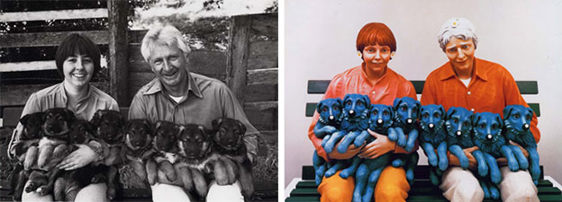
Rogers vs. Koons
Notes:
1. Rogers vs. Koons
Case
Photographer Art Rogers shot a photograph of a couple holding a line of puppies in a row and sold it for use in greeting cards and similar products. Internationally, renowned artist Jeff Koons in the process of creating an exhibit on the banality of everyday items, ran across Rodgers’ photograph and used it to create a set of statues based on the image. Koons sold several of these structures, making a significant profit. Upon discovering the copy, Rodgers sued Koons for copyright. Koons responded by claiming fair use by parody.
Outcome
The court found the similarities between the 2 images too close, and that a “typical person” would be able to recognize the copy. Koon’s defense was rejected under the argument that he could have used a more generic source to make the same statement — without copying Roger’s work. Koons was forced to pay a monetary settlement to Rodgers.
Significance
This is one of those famous cases that encompassed a larger issue in the art world, the issue of appropriation art. Can you build upon another’s work to create your own original piece? And if you do so, does that constitute derivative work? It also brought up the issue of photography as art, was photography just a documentation of the world, or is it a creative and artistic product? Neither of these issues was entirely answered by the case, of course, but it has also become a reference used in many cases afterward.
You can parallel this with vector-tracing a photograph for your design. Are you creating a derivative work that subtracts value from the original artist?

Slide 15
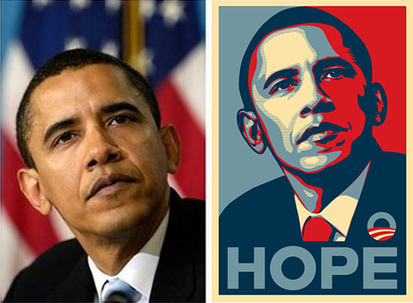
The Associated Press vs. Fairey
Notes:
2. The Associated Press vs. Fairey
Case
Famous street artist Shephard Fairey created the Hope poster during President Obama’s first run for presidential election in 2008. The design rapidly became a symbol for Obama’s campaign, technically independent of the campaign but with its approval. In January 2009, the photograph on which Fairey allegedly based the design was revealed by the Associated Press as one shot by AP freelancer Mannie Garcia — with the AP demanding compensation for its use in Fairey’s work. Fairey responded with the defense of fair use, claiming his work didn’t reduce the value of the original photograph.
Outcome
The artist and the AP press came to a private settlement in January 2011, part of which included a split in the profits for the work.
Significance
Though there wasn’t a court case and an actual verdict, this case created a lot of discourse around the value of work in these copyright battles. It’s unlikely that Garcia’s work could have ever reached the level of fame it did, if not for Fairey’s poster. Garcia himself stated he was “so proud of the photograph and that Fairey did what he did artistically with it, and the effect it has had,” but still had a problem with the fact that Fairey took the image without permission and without credit for it’s originator.
Credit, credit, credit! On 99designs you cannot use licensed work — but in the right circumstances you can use stock imagery. When doing so, make sure everyone knows the source.

Slide 16
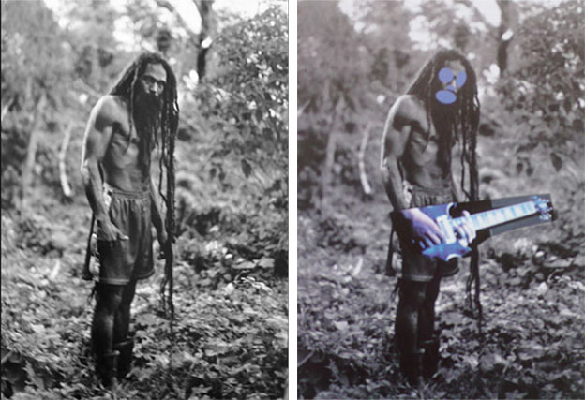
Cariou vs. Prince
Notes:
3. Cariou vs. Prince
Photograph: Patrick Cariou – 2000; Adaptation: Richard Prince – 2008 (both via artnet)
Case
Richard Prince is a well known appropriation artist — one who transforms the work of others to create new meaning in his own work. For an exhibition in the Gagosian Gallery, Prince appropriated 41 images from a photography book by French photographer Patrick Cariou, claiming fair use that he created new meaning out of the photographs. Cariou argued that it wasn’t fair use, but copyright infringement.
Outcome
A judge ruled in favor for Cariou in 2011, claiming the changes made to Cariou’s photographs weren’t significant enough to constitute a change in meaning — fair use. However, the case is currently in appeal and the final decision has not yet been reached.
Significance
The initial ruling in this case in favor of Cariou has created huge divisions in the artistic community. It brings up questions about artistic intent and the subjectivity of art, asking “who was this judge to determine whether or not the appropriated artwork had enough meaning to be considered fair use” when the art could be interpreted differently by each person who viewed it. The jury is still out on this one.
Imitation vs. inspiration
Don’t be a designer who creates work too close to that of another. You have to make sure you are creating something original and not derivative.
—
Update 4/25/2013
Not two weeks after this article was published, the original decision in this case was overturned and the judge ruled in favor of Prince for the majority of the works in dispute, claiming that Prince’s work transformed the work in the way that it was aesthetically different, and thus acceptable under the argument of fair use. Read more about the decision as well as the 5 pieces which are still under review by a lower court in The New York Times and Hyperallergic.

Slide 17
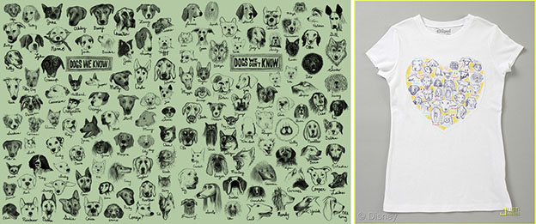
Modern Dog Design vs. Target Corporation
Notes:
4. Modern Dog Design vs. Target Corporation
Illustrations: Modern Dog – 2008; T-shirt: Target (both via Business Insider)
Case
Seattle design firm Modern Dog utilized a series of sketches of dogs in their compendium put out by Chronicle Books in 2008. The firm alleges that illustrations from that design have been used in a T-shirt produced by Disney/Target for sale, and filed a lawsuit in 2011.
Outcome
TBD. There hasn’t been a decision yet in this case but Modern Dog has been campaigning online pretty heavily for publicity and funds to help with its legal fees over the issue.
Significance
The Modern Dog case has brought to light a question burning in the mind of many designers and artists — what happens if a major corporation with many more resources than me, utilizes my artwork for profit? Modern Dog was recently forced to sell their studio to cover the legal costs associated with this battle, so it’s turning into a very extreme situation for them. We’ll have to keep an eye out for how this progressed and continues to change the conversation around this issue.
Always defend your designs. Regardless of who you’re going up against — if you think your design is in the right, then make it known.

Slide 18
Vanilla Ice vs. David Bowie/Freddie Mercury
Vanilla Ice MTV Interview
Notes:
5. Vanilla Ice vs. David Bowie/Freddie Mercury
Video: DF Bothma (via YouTube)
Case
Vanilla Ice had a hit, in 1991, with Ice Ice Baby — it sampled but did not credit the song Under Pressure by David Bowie and Queen. Though at first denying it, Vanilla Ice later retracted the statement saying it was “a joke”. Facing a lawsuit by the duo, Vanilla Ice fessed to sampling the work.
Outcome
The case was settled privately out of court with Ice paying an undeclared sum of money and crediting Bowie/Queen on the track.
Significance
There’s really not a ton of meaning directly related to design with this one (except for, don’t use other people’s creative work!). But I couldn’t resist adding it. This is one of the most hilarious copyright cases ever.

Slide 19
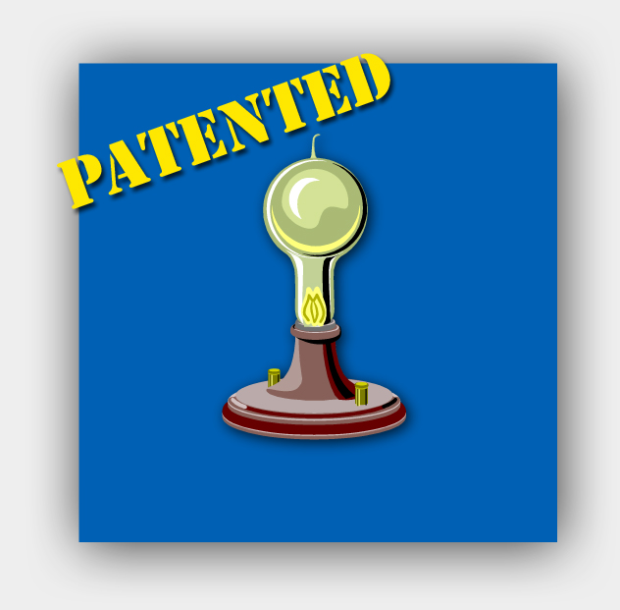
Section 8.1 Types of Property
A patent is an exclusive right granted to an inventor to make, use, or sell an invention.

Slide 20
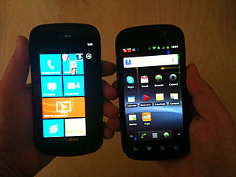
Apple vs. Samsung
Notes:
Apple walks away with a ruling that Samsung copied the iPhone. Samsung will appeal and look to have the decision mitigated as much as possible. And over in the corner, Microsoft and Nokia look at each other, nod their heads, and smile. This was a good court verdict for Windows Phone.
Round one of the Apple/Samsung patent dispute is over, with Apple in the ascendancy. The public perception is not going to be over certain models of older Samsung handsets, the exact patents and software methods used, or the differences between Samsung’s UI layer TouchWiz and Google’s default Android UI layer.
It’s going to be ‘Android copied the iPhone’.
For the last year, every review of Windows Phone powered handsets has noted the radically different UI formerly known as Metro. It does take a little getting used to, but like any new toy once you get the basics Windows Phone is as fast and capable for the majority of smartphone users. There’s no chance that Windows Phone will be mistaken for iOS (and if it was, part of Apple’s evidence was the licensing of certain patents to Microsoft for use in their smartphone OS).
Everyone is expecting Nokia to announce the first Windows Phone 8 smartphone next month on September 5th. It’s an event that’s sure to get coverage (even if it is in a rather busy period of announcements from companies that are trying to get in before Apple’s September 12th event). Nokia and Microsoft have been handed a competitive advantage.
In a world where Android has copied iOS, they are going to waltz up to the press and go ‘look at our phone, you can think differently!’ Another subtle dig at Android, a strong selling point to consumers, and a key differentiator in the smartphone ecosystem. Samsung is handed the lemons, but it’s Nokia that will get to make the first batch of lemonade.
What happens now to Android as a whole is going to be very interesting. While the appeals process for this case may go on for some time, there will be a chilling effect on other manufacturers, who will be watching the cost of licensing the patents on the ‘free’ Android OS with trepidation. Expect Apple to be drafting invoices in the very near future. But will the manufacturers who just want a modern smartphone OS turn away from the uncertainty in Android? Will they want a solution that is fully licensed, covers all the patents, and will let them stand out in the marketplace? If so, Microsoft are going to welcome them with open arms.
And when Windows Phone 8 get the traction that many expect it will, what will Samsung do?
They are on top of the heap at the moment with the Galaxy range of devices, but they also have something interesting on the back burner. The Focus range… essentially the Galaxy hardware but running Windows Phone rather than Android OS. They’ve already said Windows Phone 8 devices will be arriving before the end of 2012, could they now put a little more emphasis on the Windows Phone line?
The last thing Samsung will want to do is be left stranded in the courts holding their Android football while everyone else runs ahead to score with Windows Phone handsets. Nokia are all-in on the new platform, HTC could see it as a way to bypass Samsung’s dominance in Android, and both Huawei and ZTE are ready to leverage Microsoft’s OS.
Samsung was probably planning to do just enough to stay involved in Windows Phone at the start of this year, but I expect them to take a bit more interest in the platform, do a little bit more marketing of their new Windows Phone handsets, and to put more skin in the game to make sure they’re not left without a chair when the music stops.
Apple took the victory, Samsung lost in court, but the true winner looks to be Microsoft.

Slide 21
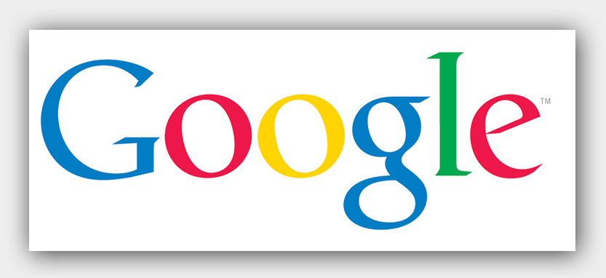
Section 8.1 Types of Property
A trademark is a word, phrase, symbol, or design that identifies and distinguishes a product from other products.
TM

Slide 22
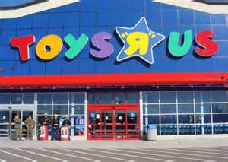

Toys R Us vs Guns R Us
Notes:
Plaintiffs Toys "R" Us, Inc. and Geoffrey, Inc., licensee and owner respectively of the Toys "R" Us trademark, bring this action against defendants, appearing pro se, in connection with defendants' use of the trade names "Guns Are Us," "Guns are We," and the internet domain name "gunsareus.com." The action states claims arising under the Lanham Act, 15 U.S.C. §§ 1114(1), and 1125(a), and New York commercial and trademark law. Plaintiffs move for summary judgment. For the reasons stated herein, plaintiffs' motion is denied in its entirety, and summary judgment is granted in favor of defendants.
CONCLUSION
For the reasons set forth above, plaintiffs' motion for summary judgment is denied in its entirety, and summary judgment is granted in favor of defendants. The Clerk of the Court is directed to enter judgment dismissing the complaint and to close the file in this action.
Music and Movie Copyright Infringement
Here are some common ways that infringement of copyright may happen.
File Sharing Sites – While the heyday of Napster may be gone, bittorrent and other technologies are still being used to illegally share copyrighted files – primarily music and movies, but other intellectual property as well.
Emailing a Friend – Even simply emailing a copy of a copyrighted song to all of the people in your contact book could be considered copyright infringement.
Physical Copies – If you burn a CD of music you have downloaded for free on the Internet and give it to all of your friends, this could be considered copyright infringement.
As you can see, there are many different activities that could get a person in trouble with the legal system. Media companies have been known to sue individuals who share or even just acquire copyrighted works illegally.
Avoiding Copyright Infringement
Here are a few tips and suggestions to avoid problems with copyright infringement – which can be quite expensive.
Always Know - Whenever a photo, text, video or other creative work is used, the exact ownership of that content or work should be known before it is used or reused.
Double Check – If the copyright information is not known or is thought to be known about, it is a good idea to double check in order to make sure there is no infringement of the copyright holder.
What to Check – Most websites will have a “terms of use” somewhere that will tell a person how the materials may be legally used or if they should not be used at all. However, the lack of a terms of use does not mean that the works can be used. It may be necessary to contact the owner of the works to get their explicit permission.
Public Domain – Another idea is to use photos or other materials that are in the public domain. There is quite a bit of works now in the public domain, with more and more material entering the public domain all the time. It should be noted that other people also have the ability to use public domain content and works, however, so the value may not be as high as if the public domain work is used to come up with a new work.
Fair Use – Additionally, there may be cases where fair use applies to copyrighted material. Understanding fair use is important to avoid copyright infringement charges and accusations.
There are other things you should do to avoid copyright infringement, but these tips and suggestions should help make sure you do not run into any problems. The most important thing is to remember that if you do not know you need to check. You should never assume that a work is not copyrighted or that fair-use can be applied.
Going After Copyright Infringement
If someone is infringing on your copyrighted work, you may be able to take them to court and successfully win a suit against them. The burden of proof falls on the owner of the copyright. Hiring a good copyright attorney can help considerably with going after people and companies who infringe on your copyrighted content – whether it’s music, photos, or even stories or articles.
DMCA Notice of Copyright Infringement
There are many examples of DMCA notices for copyright infringement on the Internet. Searching for these and comparing all the different examples is a good way to come up with a standard DMCA complaint on your own. However, having a good copyright lawyer on your team can help considerably with putting together a DMCA complaint that will be noticed and effective.

Slide 23

Chapter 8
Assessment
Personal
Property

Slide 24
1. Most personal property is acquired by:
  purchasing it
  receiving it as a gift
  inheriting it
  all of the above

Slide 25
2. You have a right to keep stolen property if you did not know it was stolen.
True or False

Slide 26
3. The exclusive right to reproduce and sell a work of art is called a:
  patent
  copyright
  trademark
  logo

Slide 27
4. Give two examples of tangible personal property and one example of intangible personal property.
5. What are the three requirements of completed gift?
6. When is copying allowed without permission?

Slide 29
Have you ever found something that did not belong to you? What did you do? Did you feel that you needed to find who it belonged to? Was there a reward? Were you compensated at all?

