Slide 1
Learning Objectives
LO6 Record the acceptance of a note receivable.
LO7 Account for the collection of a note receivable.
LO8 Account for a dishonored note receivable.
© 2014 Cengage Learning. All Rights Reserved.

Slide 2
Understanding Promissory Notes
Lesson 14-3
A written and signed promise to pay a sum of money at a specified time is called a promissory note.
A person or business to whom a liability is owed is called a creditor.
A promissory note signed by a business and given to a creditor is entered in the businesses books as a note payable.
A promissory note that a business accepts from a customer is entered in the business’s books as a note receivable.
Notes payable and notes receivable are frequently referred to simply as notes.
The person or business that signs a note, and thus promises to make payment, is called the maker of a note.
Continued on the next slide.

Slide 3
Understanding Promissory Notes
Lesson 14-3
The person or business to whom the amount of a note is payable is called the payee.
The original amount of a note, sometimes referred to as the face amount, is called the principal.
The percent of the principal that is due for the use of the funds secured by a note is called the interest rate.
The date on which the principal of a note is due to be repaid is called the maturity date.
The length of time from the signing date to the maturity date, usually expressed as the number of days, may be referred to as the time of a note, or term.

Slide 4
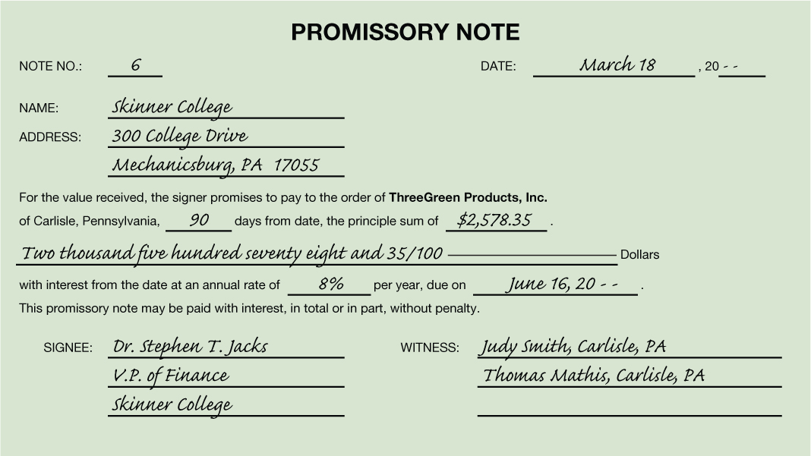
Understanding Promissory Notes
Lesson 14-3
Number Assigned to the Note
Date the Note Is Signed
Time of the Note
Payee
Principal
Maturity Date
Interest Rate
Maker of the Note
Witness

Slide 5
Accepting a Note Receivable from a Customer
Lesson 14-3
LO6
March 18. Accepted a 90-day, 8% note from Skinner College for an extension of time on its account, $2,578.35. Note Receivable No. 6.
GENERAL LEDGER
Notes Receivable
Mar. 18 2,578.35
Accounts Receivable
Bal. 20,486.25
(New Bal. 17,907.90)
Mar. 18 2,578.35
ACCOUNTS RECEIVABLE LEDGER
Skinner College
Bal. 2,578.35
(New Bal. 0.00)
Mar. 18 2,578.35

Slide 6
Accepting a Note Receivable from a Customer
Lesson 14-3
LO6
March 18. Accepted a 90-day, 8% note from Skinner College for an extension of time on its account, $2,578.35. Note Receivable No. 6.
2
Account Title
Note Receivable Number
4
Debit Amount
3
Date
1
5
Account Title and Customer Name
Diagonal Line
Credit Amount
6
7

Slide 7
Interest on Promissory Notes
Lesson 14-3
LO7
An amount paid for the use of money for a period of time is called interest.
Principal | × | Annual Interest Rate | × | Time as Fraction of a Year | = | Interest for Fraction of Year
$2,578.35 | × | 8% | × | 90/360 | = | $51.57
The amount that is due on the maturity date of a note is called the maturity value.
Principal | + | Interest | = | Maturity Value
$2,578.35 | + | $51.57 | = | $2,629.92

Slide 8
Maturity Date of Promissory Notes
Lesson 14-3
LO7
Number of days of the first month
Days remaining after this month
1
2
 | Days from the Month | Days Remaining
Term of the Note |  | 90
March 18–March 31 | 13 | 77
April | 30 | 47
May | 31 | 16
June 1–June 16 | 16 | 0
Lesser of the days of the month and the days remaining after the previous month
3
4
Days remaining for the last month

